Slide 1
Object Classification and Recognition
Shreenidhi Sudhakar

Slide 2
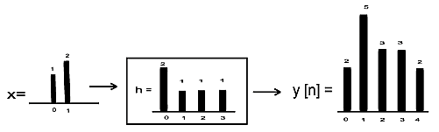
Convolution
x = linear signal
h = impulse signal
y = convolved signal

Slide 3
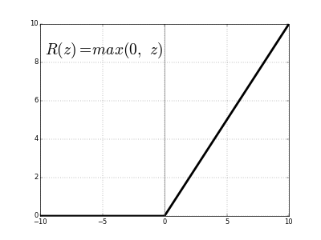
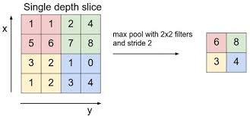
ReLu and Max Pooling
ReLU
Max Pool

Slide 4
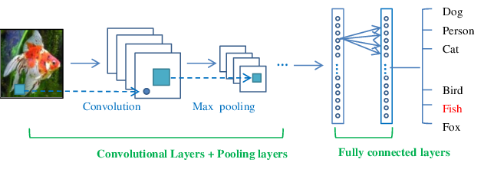
Convolution Neural Network

Slide 5
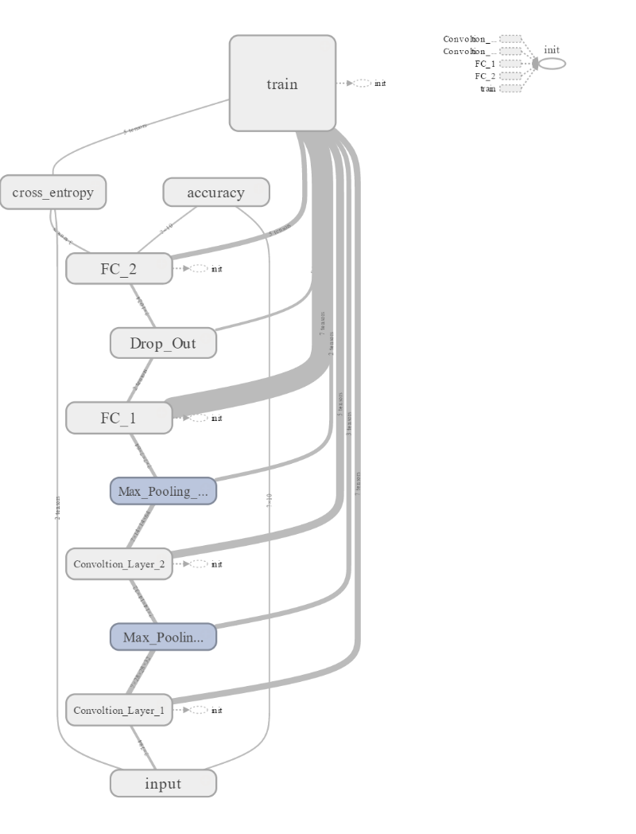
Results
FC = Fully Connected Layer
Results are obtained using TensorBoard
Visualization Tool In TensorFlow

Slide 6
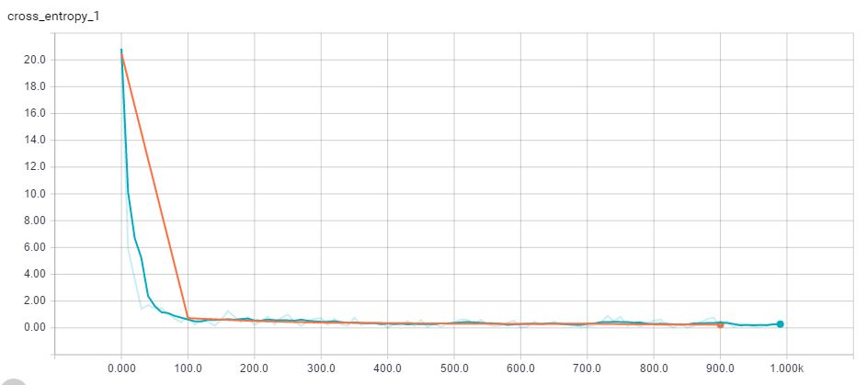
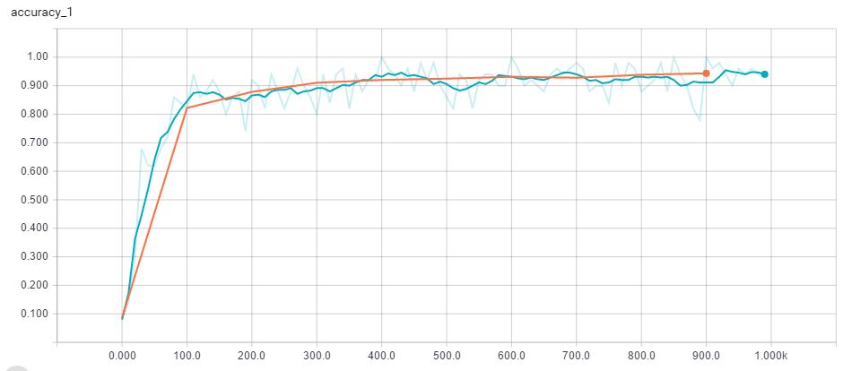
Results
Cross Entropy
Accuracy

Slide 7
Real Time Application
Video Analysis
Image Recognition
Natural Language Processing
Semantic parsing, search query retrieval, sentence modeling

Slide 8
Thank You
Check Out: shreenidhi.azurewebsites.net

